Slide 1
Amazon CloudFront
Lecturer: Ngo Huy Bien
Software Engineering Department
Faculty of Information Technology
University of Science
Ho Chi Minh City, Vietnam
nhbien@fit.hcmus.edu.vn

Slide 2

Objectives

Slide 3

Contents

Slide 4

References

Slide 5
Amazon CloudFront
https://aws.amazon.com/cloudfront/
Amazon CloudFront is a content delivery network (CDN) service built for high performance, security, and developer convenience.

Slide 6
Why Amazon CloudFront?
Reduce latency by delivering data through 600+ globally dispersed Points of Presence (PoPs) with automated network mapping and intelligent routing.
Improve security with traffic encryption and access controls, and use AWS Shield Standard to defend against DDoS attacks at no additional charge.

Slide 7
Amazon CloudFront vs. Cloudflare
Cloudflare uses a reverse-proxy architecture to manage data. Rather than use cloud providers' default name servers, websites and apps are configured to use Cloudflare's nameservers. Requests go through Cloudflare servers, which determine how to route traffic.
In Amazon CloudFront, IT teams don't change name server settings. Instead, they set up copies -- called distributions -- of the data they want to distribute. These data distributions have unique URLs, and admins use the URLs to help direct requests to the CloudFront CDN. The tool decides which server within the network should respond to a CloudFront URL request based on the geographic origin of the request.

Slide 8
When to Use Amazon CloudFront?
https://aws.amazon.com/cloudfront/customers/

Slide 9
1. Download hello-world-html.zip
https://docs.aws.amazon.com/AmazonCloudFront/latest/DeveloperGuide/samples/hello-world-html.zip

Slide 10
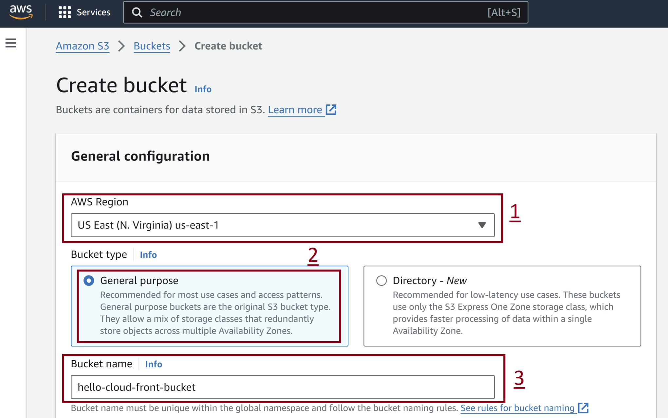
2. Create S3 Bucket

Slide 11
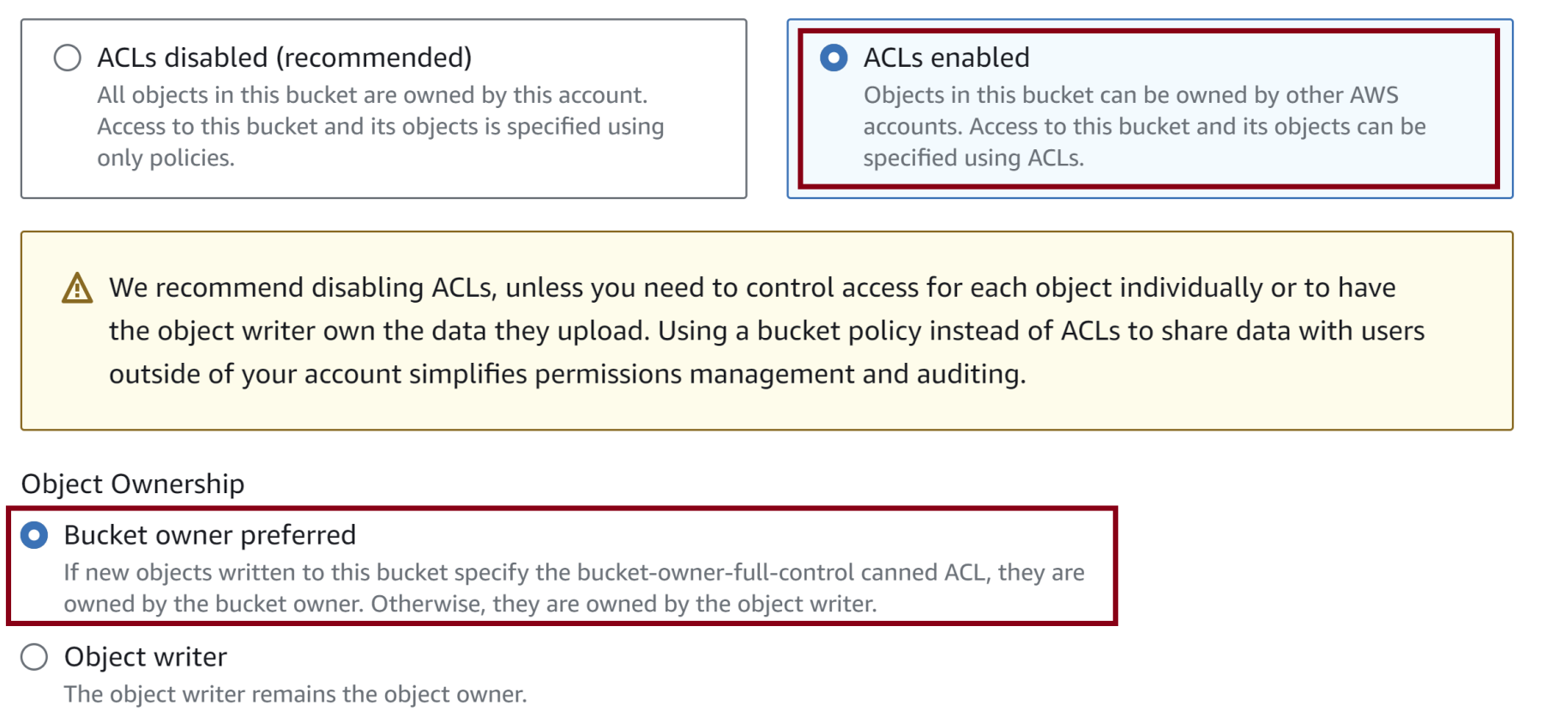
3. Enable S3 Bucket ACLs

Slide 12
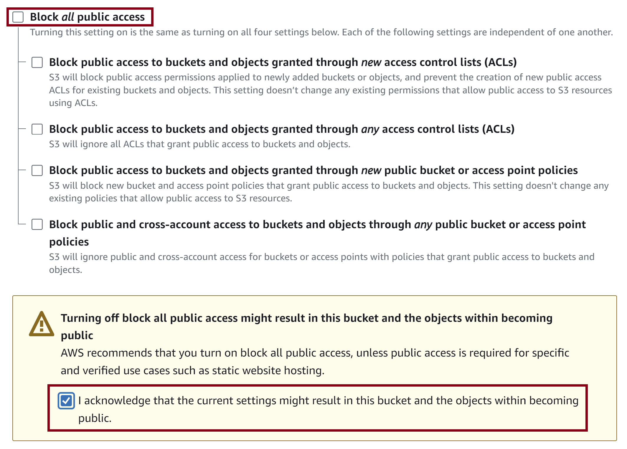
4. Enable Public Access

Slide 13
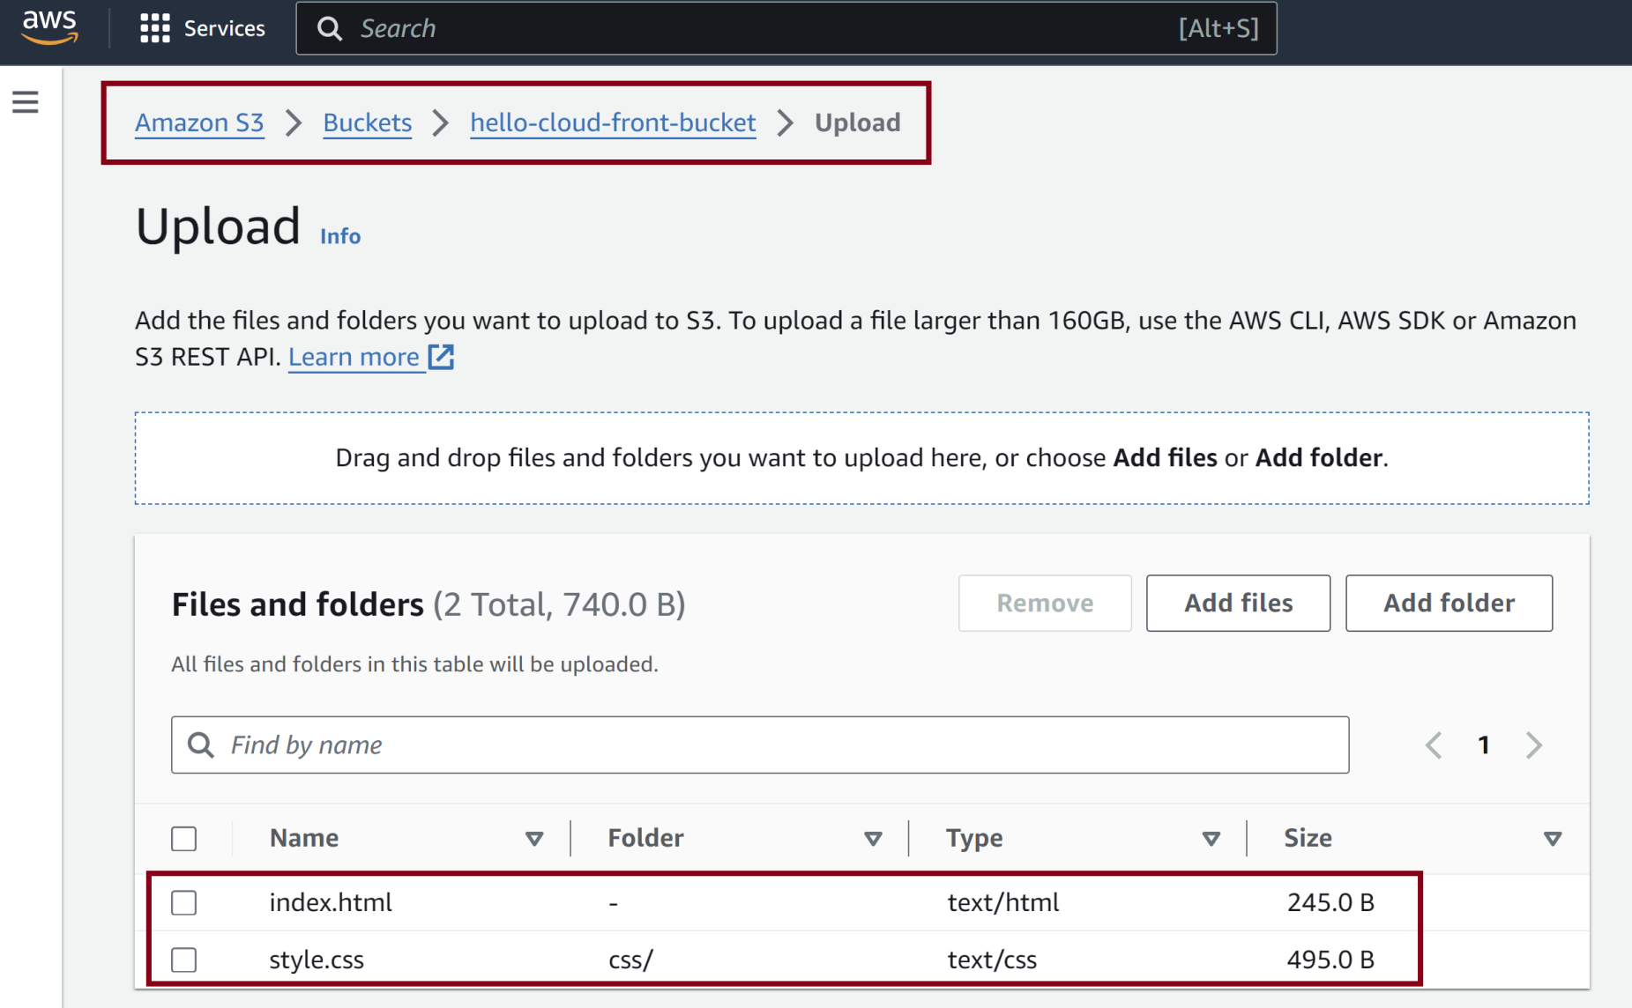
5. Upload Content

Slide 14
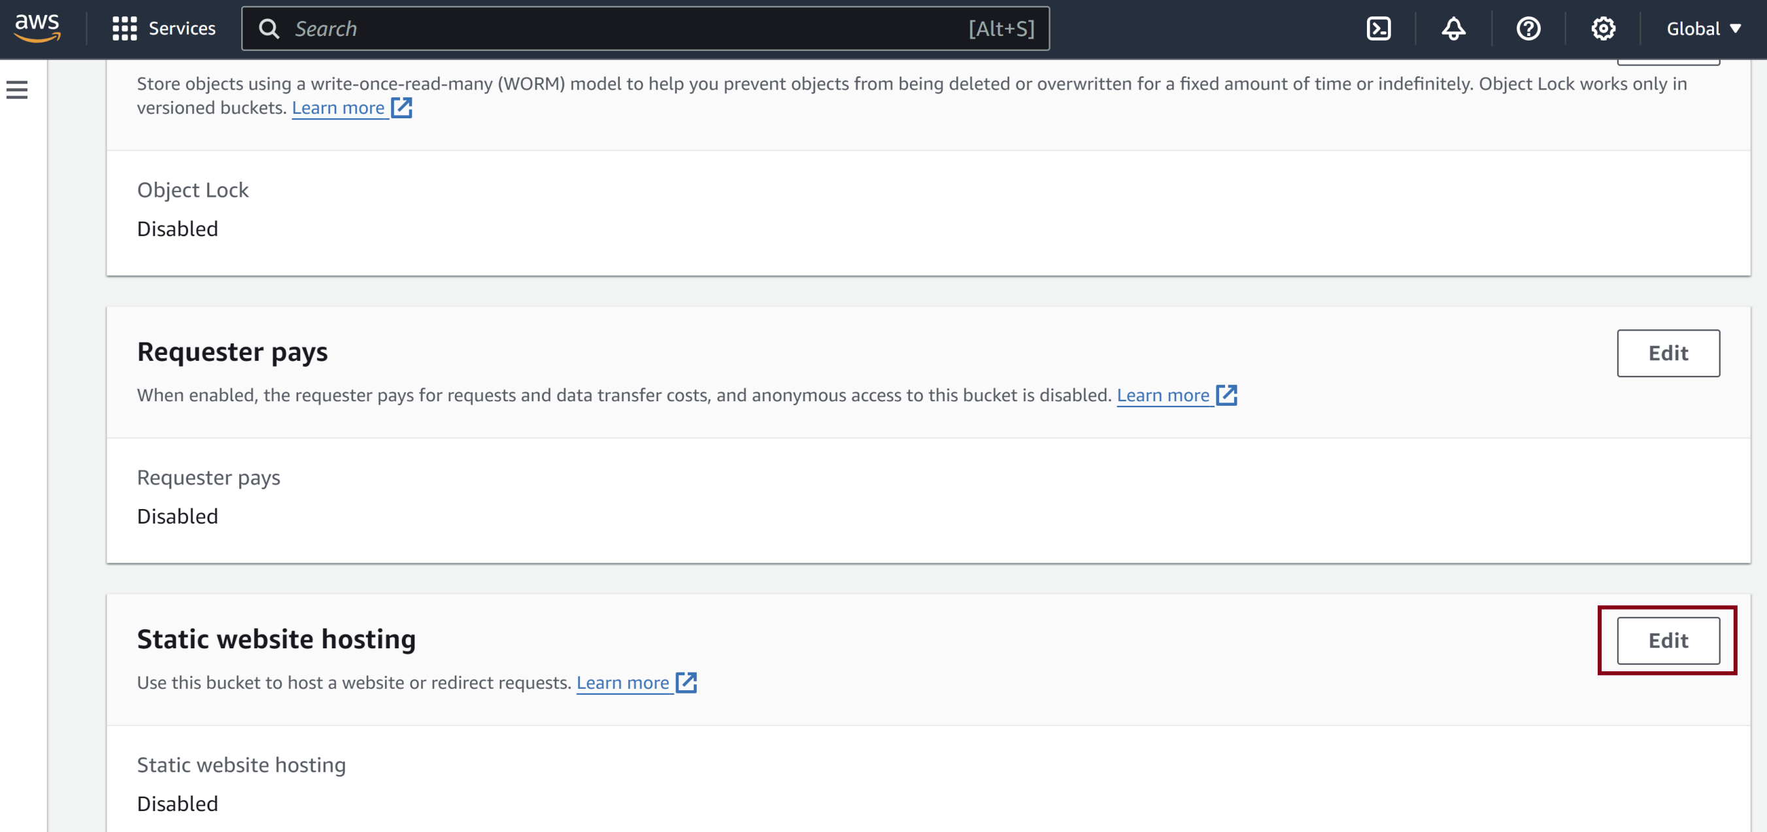
6. Enable Bucket Static Website Hosting
Go to bucket Properties.

Slide 15
7. Add a bucket policy
Go to Permissions → Bucket Policy, choose Edit.
{
"Version": "2012-10-17",
"Statement": [
{
"Sid": "PublicReadGetObject",
"Effect": "Allow",
"Principal": "*",
"Action": [
"s3:GetObject"
],
"Resource": [
"arn:aws:s3:::hello-cloud-front-bucket/*"
]
}
]
}

Slide 16
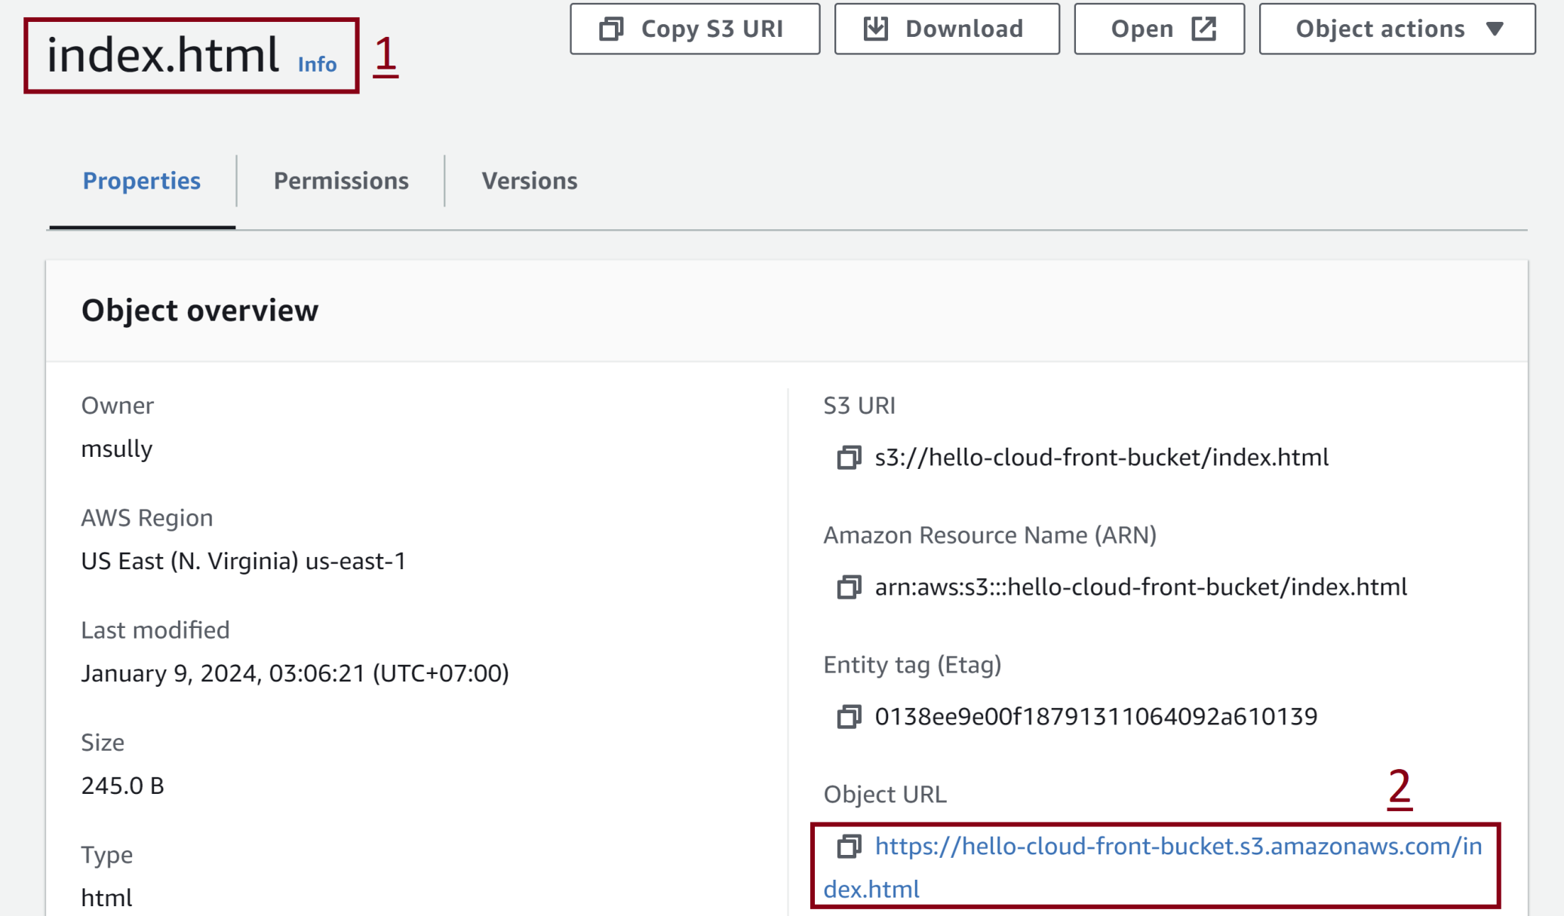
8. Test URL

Slide 17
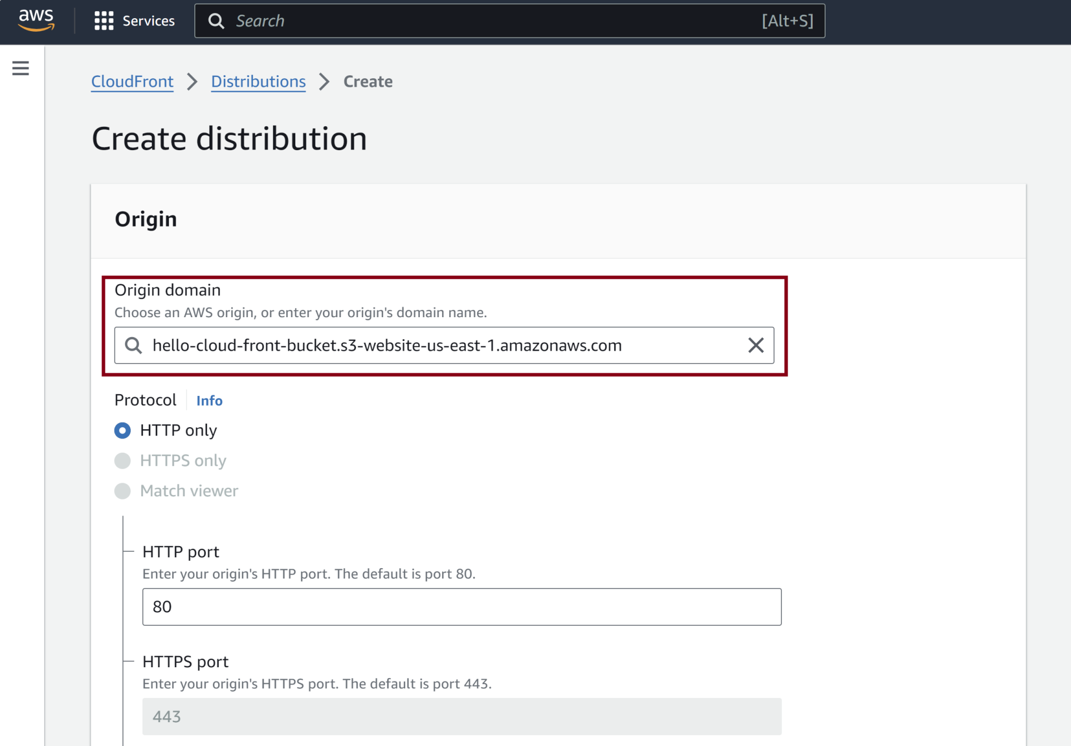
9. Create a CloudFront distribution

Slide 18
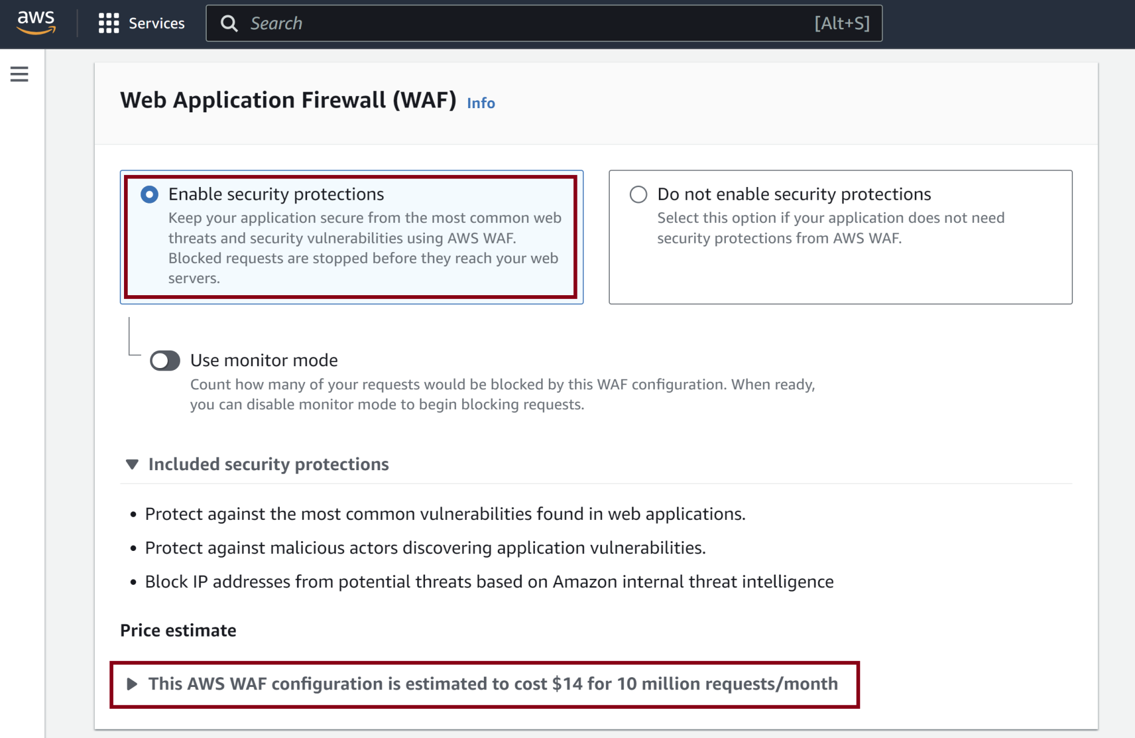
10. Select WAF Option

Slide 19
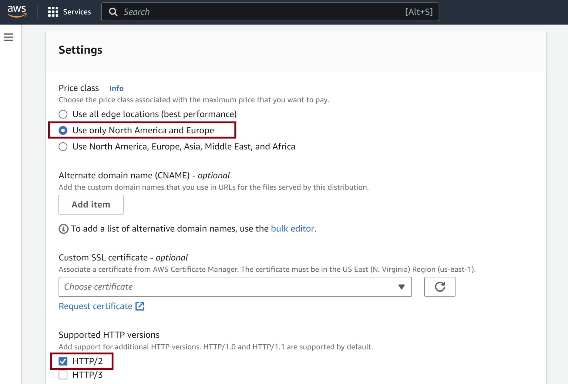
11. Select Settings

Slide 20
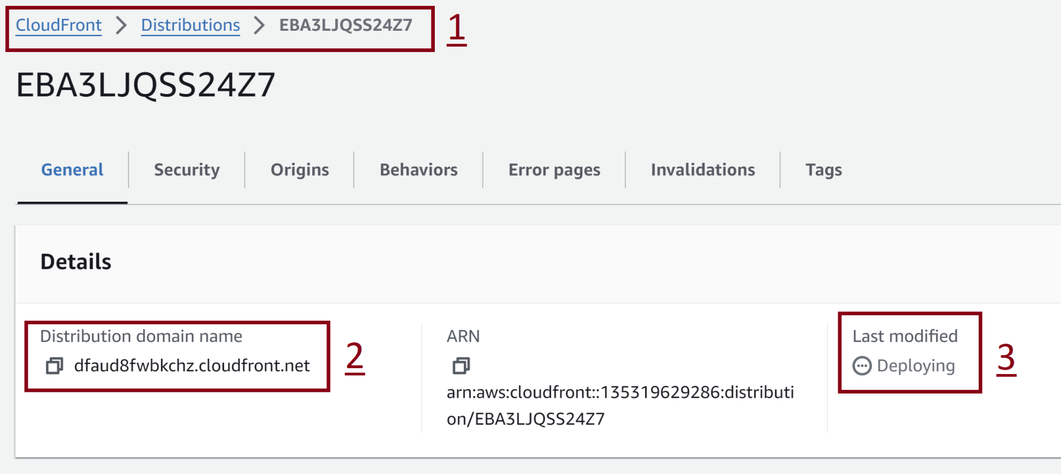
12. Retrieve Distribution Information
Wait for 5 minutes.

Slide 21
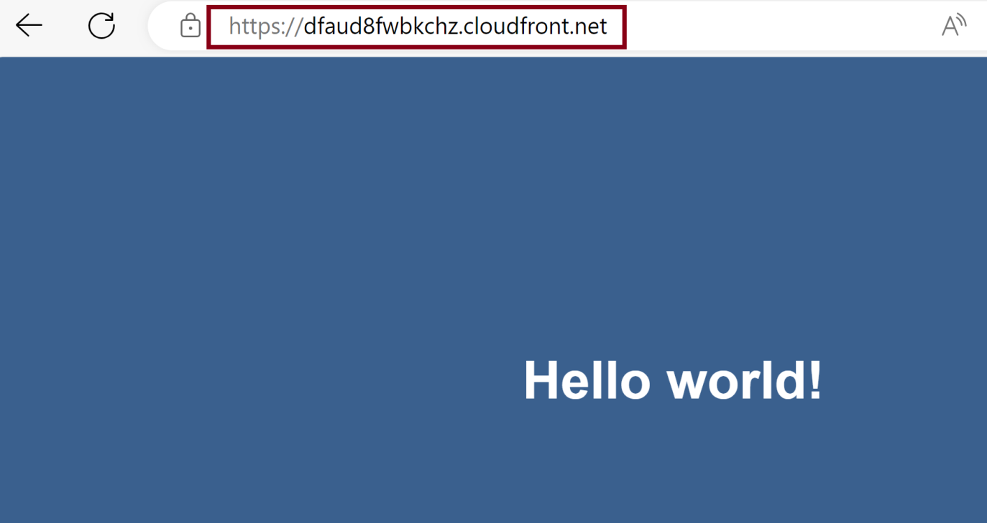
13. Test Distribution

Slide 22
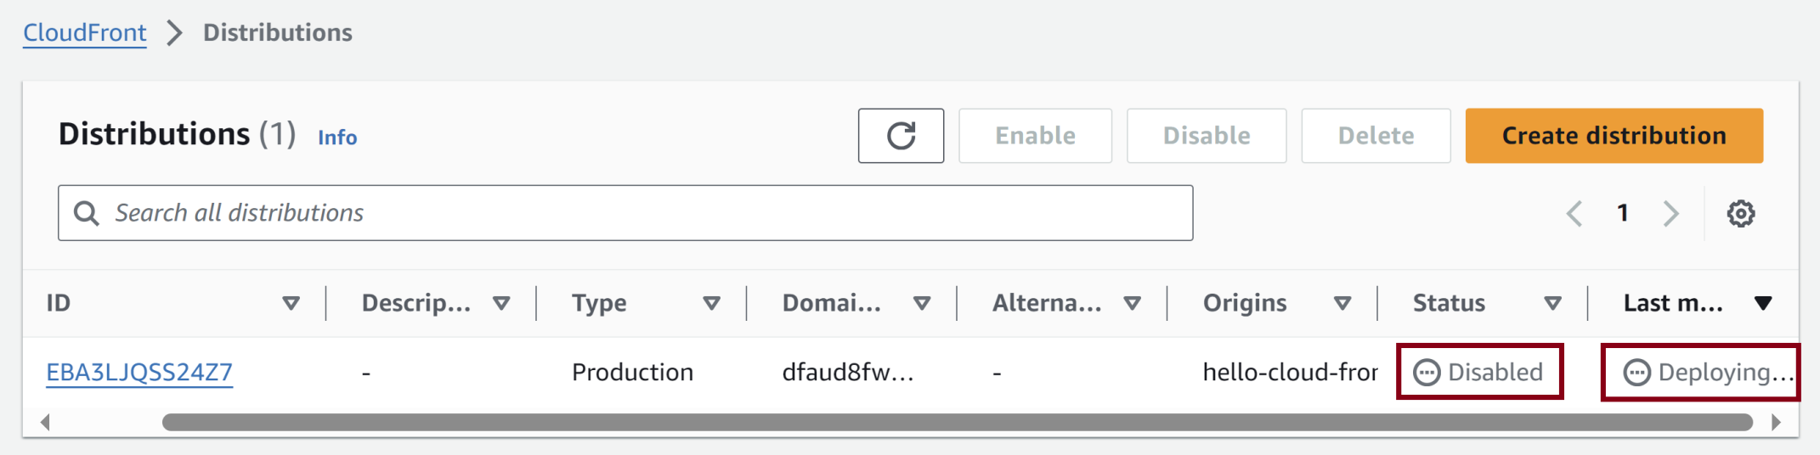
14. Disable Distribution
Wait for Deployed status.

Slide 23
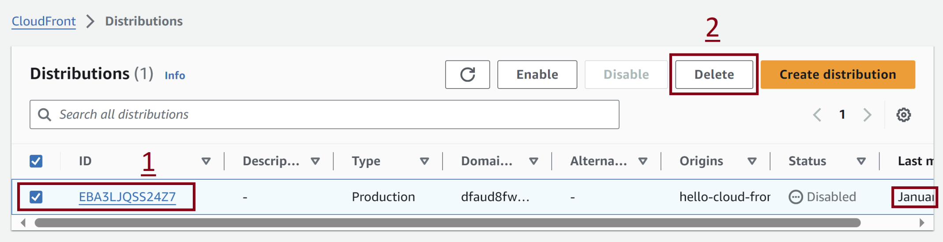
15. Delete Distribution

Slide 24

Thank You & See You Again

